Slide 1

Session Name:
Introduction to Linear Programming (LP)
Delivered By:
Mr. Ritwik Sinha

Slide 2

Linear Programming
Under some constraints, Linear Programming (LP) solves the mathematical problems of optimization
The four basic methods for solving LP problems are:
Graphical Method – For two variable problems, we solve by plotting constraints
Simplex Method – Utilizing iterative algorithm for larger LP problems
Dual Simplex Method - Solving LP problems where the initial solution is not feasible
Interior-points Method – It’s an alternative to Simplex method, used for very large problems

Slide 3

Learning Objectives
By the end of this session, you will be able to:
Define different methods of solving Linear Programming Problem
Implement different methods in Python

Slide 4
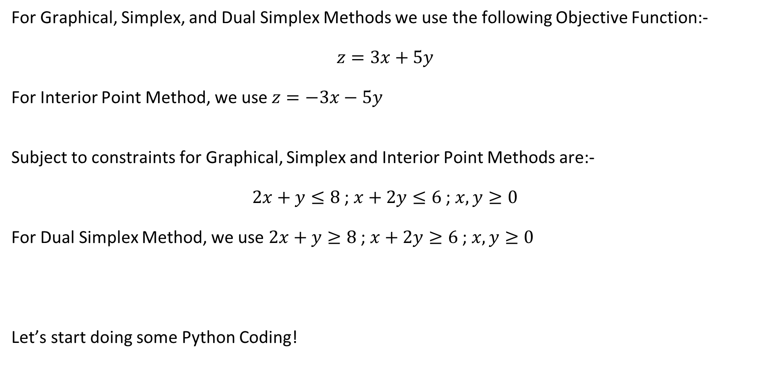
Implementing different methods in Python
For Graphical, Simplex, and Dual Simplex Methods we use the following Objective Function:-
$$z=3x+5y$$
For Interior Point Method, we use $z=−3x−5y$
Subject to constraints for Graphical, Simplex and Interior Point Methods are:-
$2x+y≤8$ ; $x+2y≤6$ ; $x,y≥0$
For Dual Simplex Method, we use $2x+y≥8$ ; $x+2y≥6$ ; $x,y≥0$
Let’s start doing some Python Coding!

Slide 5
Academic Poll
When is the Graphical Method suitable for solving LPP?
A) When there are more than two decision variables B) When there are exactly two decision variables C) When the objective function is non-linear D) When there are no constraints
What is the primary advantage of the Simplex Method over the Graphical Method?
A) It is easier to visualize solutions B) It works for problems with more than two variables C) It does not require constraint equations D) It always finds multiple optimal solutions

Slide 6
Academic Poll
When is the Graphical Method suitable for solving LPP?
A) When there are more than two decision variables B) When there are exactly two decision variables C) When the objective function is non-linear D) When there are no constraints
What is the primary advantage of the Simplex Method over the Graphical Method?
A) It is easier to visualize solutions B) It works for problems with more than two variables C) It does not require constraint equations D) It always finds multiple optimal solutions

Slide 7
Academic Poll
The Dual Simplex Method is best used when:
A) The initial solution is not feasible B) The objective function is non-linear C) The constraints are not linear D) The problem has no solution
Which of the following is a key advantage of the Interior-Point Method over the Simplex Method?
A) It is always faster than the Simplex Method B) It is better for very large-scale optimization problems C) It can handle non-linear constraints D) It is easier to understand conceptually

Slide 8
Academic Poll
The Dual Simplex Method is best used when:
A) The initial solution is not feasible B) The objective function is non-linear C) The constraints are not linear D) The problem has no solution
Which of the following is a key advantage of the Interior-Point Method over the Simplex Method?
A) It is always faster than the Simplex Method B) It is better for very large-scale optimization problems C) It can handle non-linear constraints D) It is easier to understand conceptually

Slide 9
Session Summary
In this session, we have discussed about:
Different methods of solving an LPP
Implementing these methods in Python

Slide 10

Happy Learning!

